Slide 1
Kaitlyn Rainford’s Portfolio
12/21/23

Slide 2
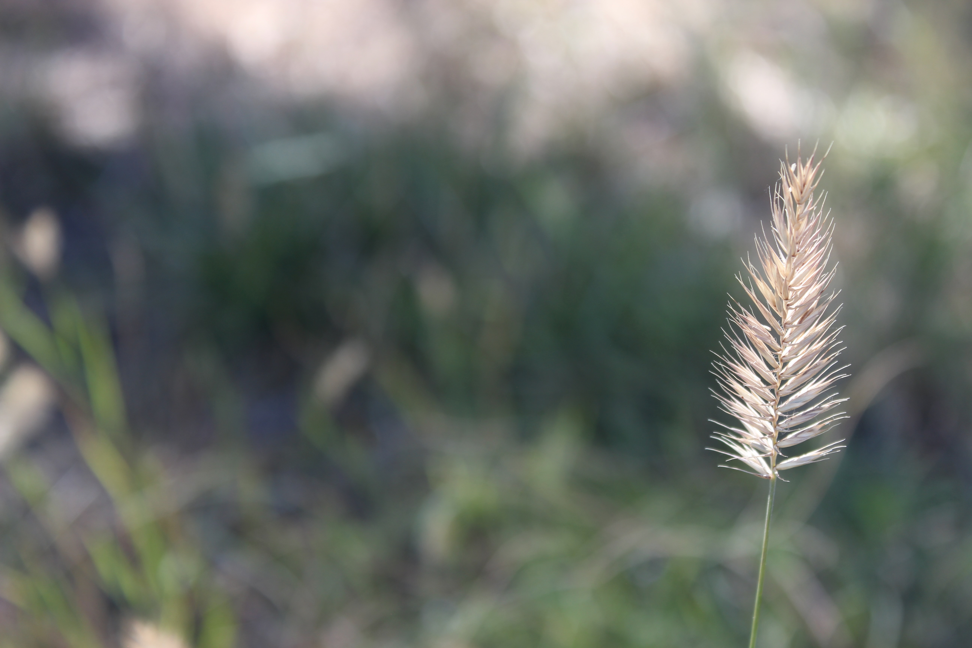
Introduction
My name is Kaitlyn Rainford and I’m a freshman at Rye high school. My experience in photography, excluding this class, was my 7th and 8th grade yearbook class. The co-teacher was the photography teacher who taught us composition of photos. My hobbies include, reading, crocheting, baking, and writing.

Slide 3
The composition of this photo helped reach the goal: to put the focus on the leaf. The lighting on the leaf, shining through it, highlighted it and made it the center of attention. The color of the leaf in contrast to the green grass also helped make it the focus of the photo.
Assignment: Different Point of View
Autumn Has Come

Slide 4
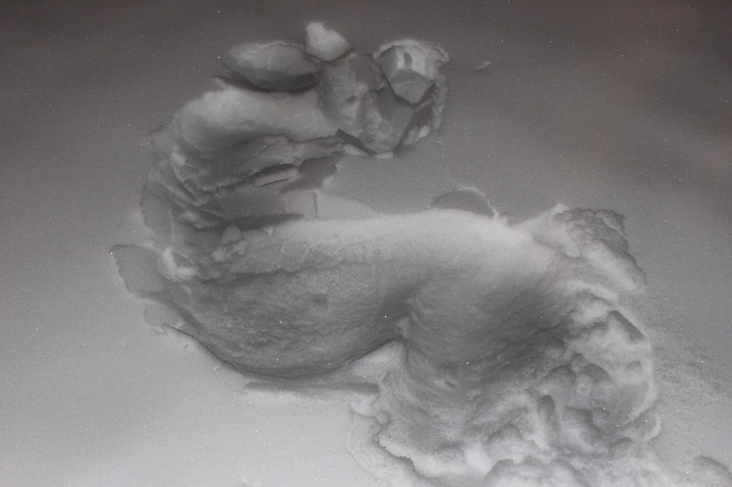
Silhouette
This photo’s goal was to show the shape of a huddled body imprinted on the snow. I edited the imprint to be darker, making it a bit more visible.
Assignment: Social Documentary Project

Slide 5
Beautiful Birch Assignment: Up Close and Detail Landscape Photos
My goal for this photo was to capture the calmness that often envelopes nature. This shown in the composition: The gentle lighting and shadows, the group of leaves on the left side of the image, and the swaying tree in the background.

Slide 6
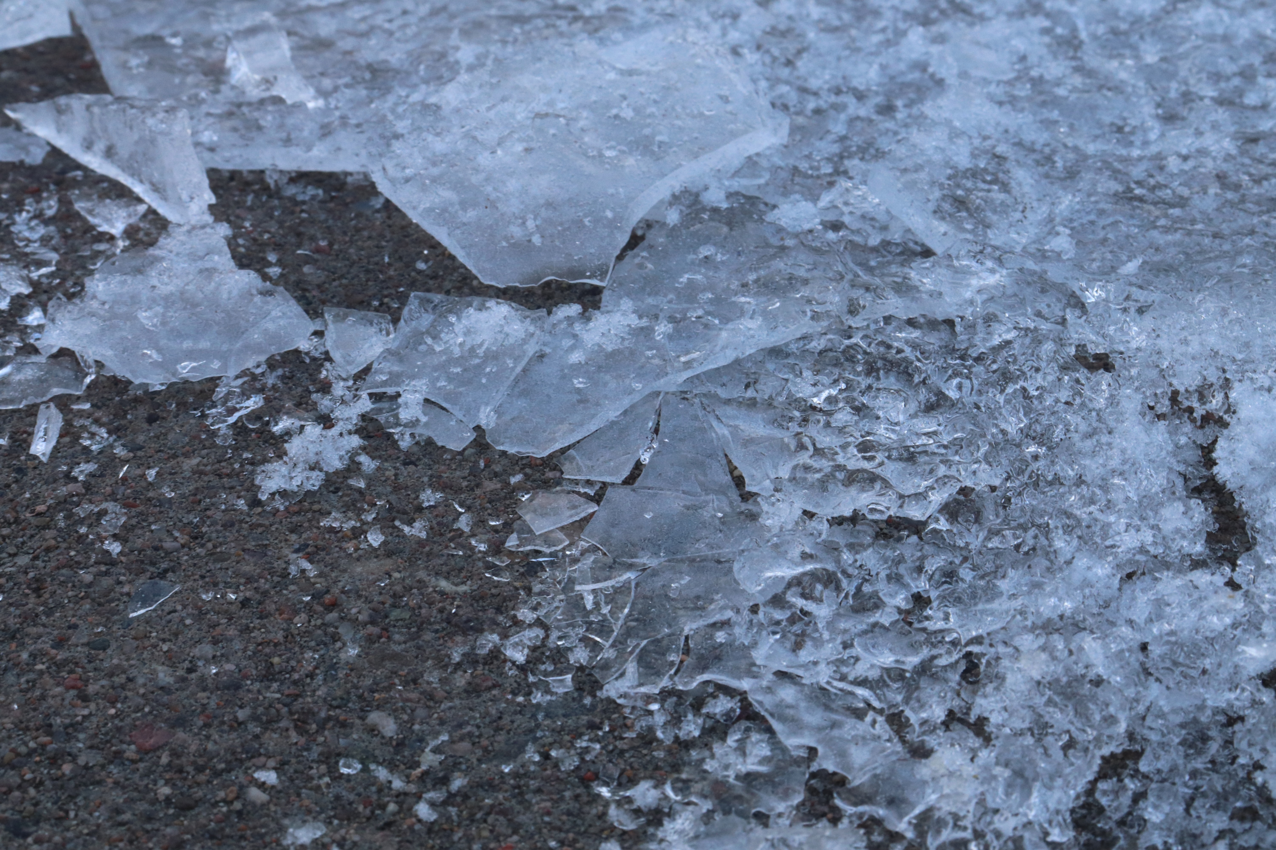
Choice
My goal for this photo was to get all the tiny pieces of ice. The shattered bits and pieces, up close in detail. The composition of this photo is one of my favorites. The gradient from solid ice, to shattered, to ground. The lighting also helped keep the cool tones of the ice.
Broken

Slide 7
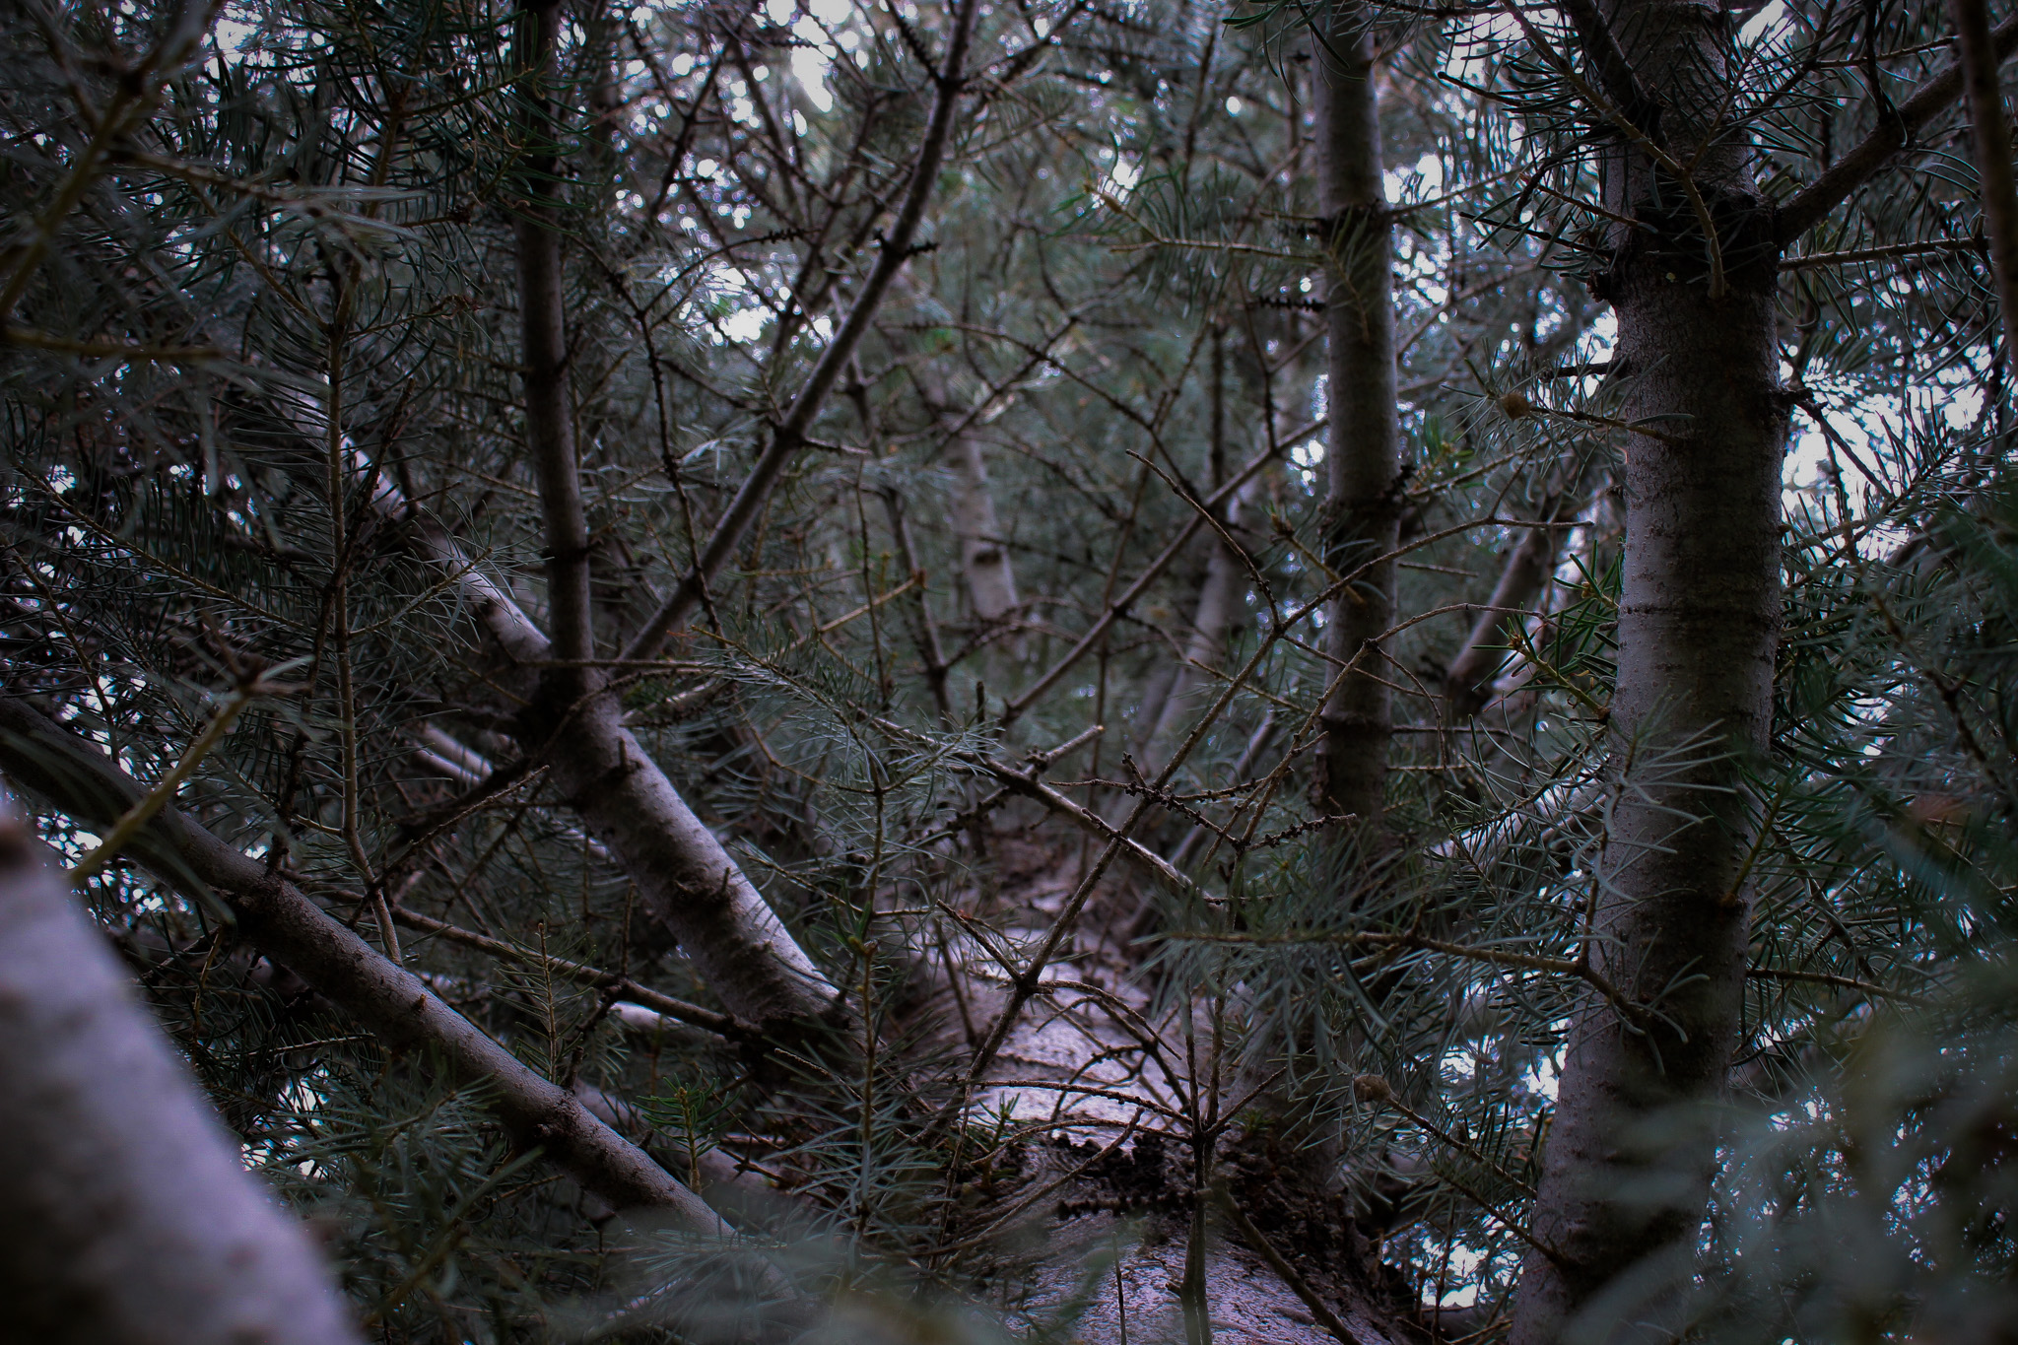
My goal with this photo was to try a different point of view. I also wanted to have balance in the composition with most of the branches on both sides while the middle was clearer. I also edited it to be darker.
A Look Into the Trees
Assignment: Composition Photos

Slide 8
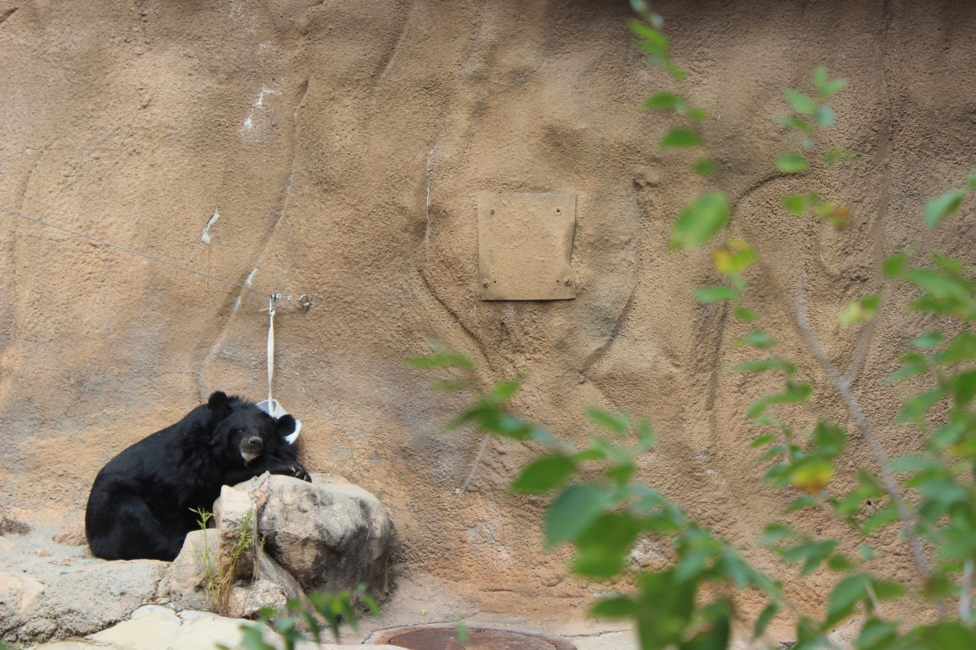
Assignment: Zoo Photos
A Little Leisure
The goal of this photo was to capture a moment of the bear relaxing. He’s leaning against the rock, having a snack. I also like the composition a lot. The leaves taking half of the picture, and the bear on the other half. The colors of the bear and the leaves also contrast well against the neutral rock enclosure. The blurriness of the leaves also help draw the attention to the bear, making him the focal point of the photo

Slide 9
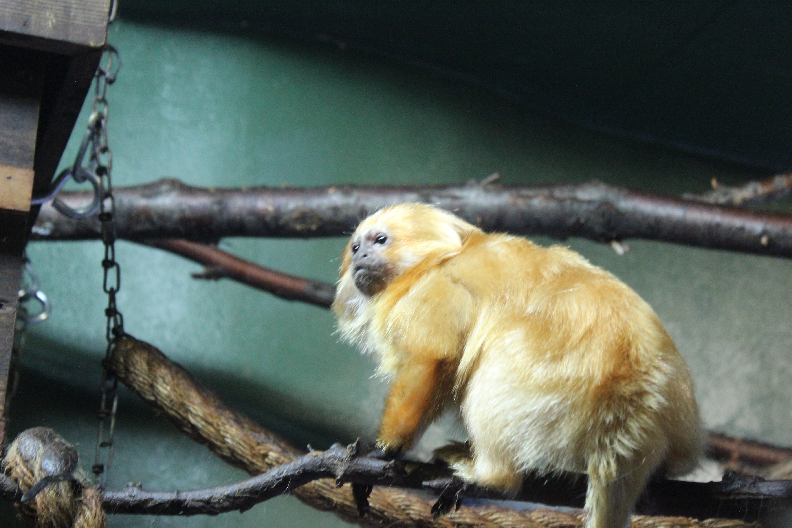
Assignment: Zoo Photos
A Distraction
In this photo, the monkey’s fur contrasts with it’s enclosure which adds the depth and helps draw attention to him. He’s also looking off in the distance, making the photo more interesting.

Slide 10
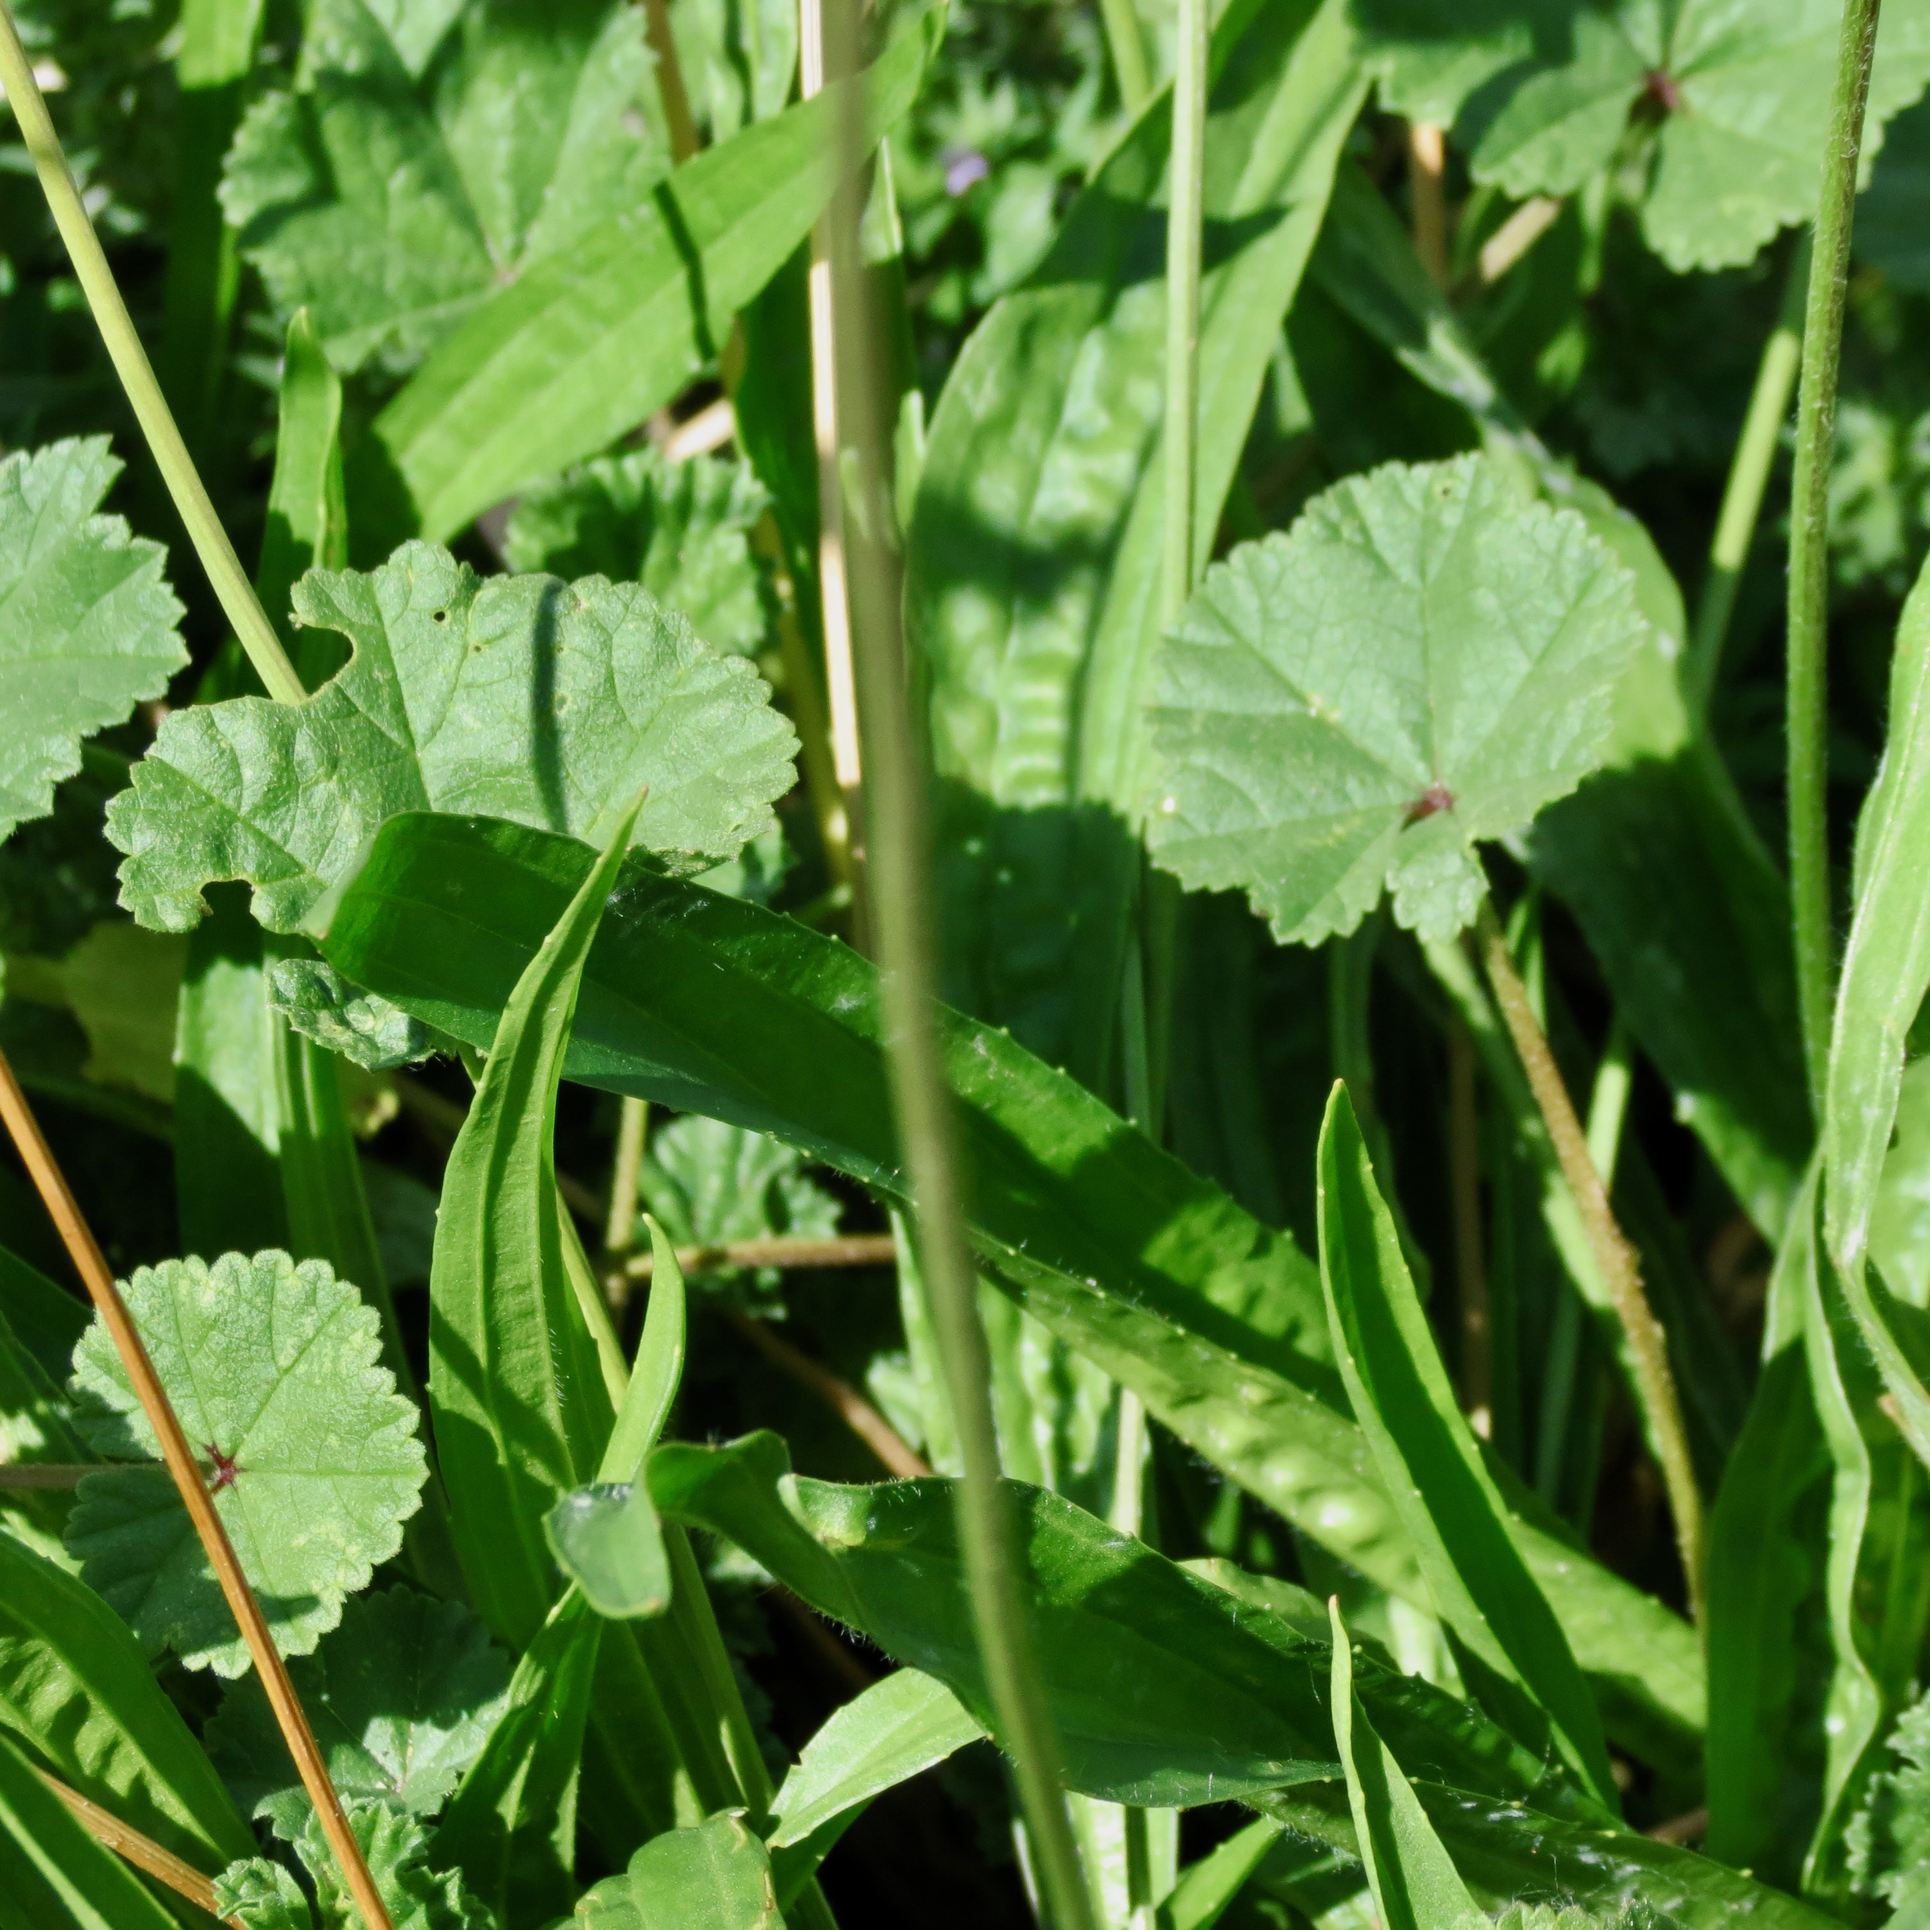
Small World
My goal for this photo was to capture the warm lighting on the grass. The depth in the layers of the grass and stems beneath their leaves add to the photo.
Assignment: Lighting

Slide 11
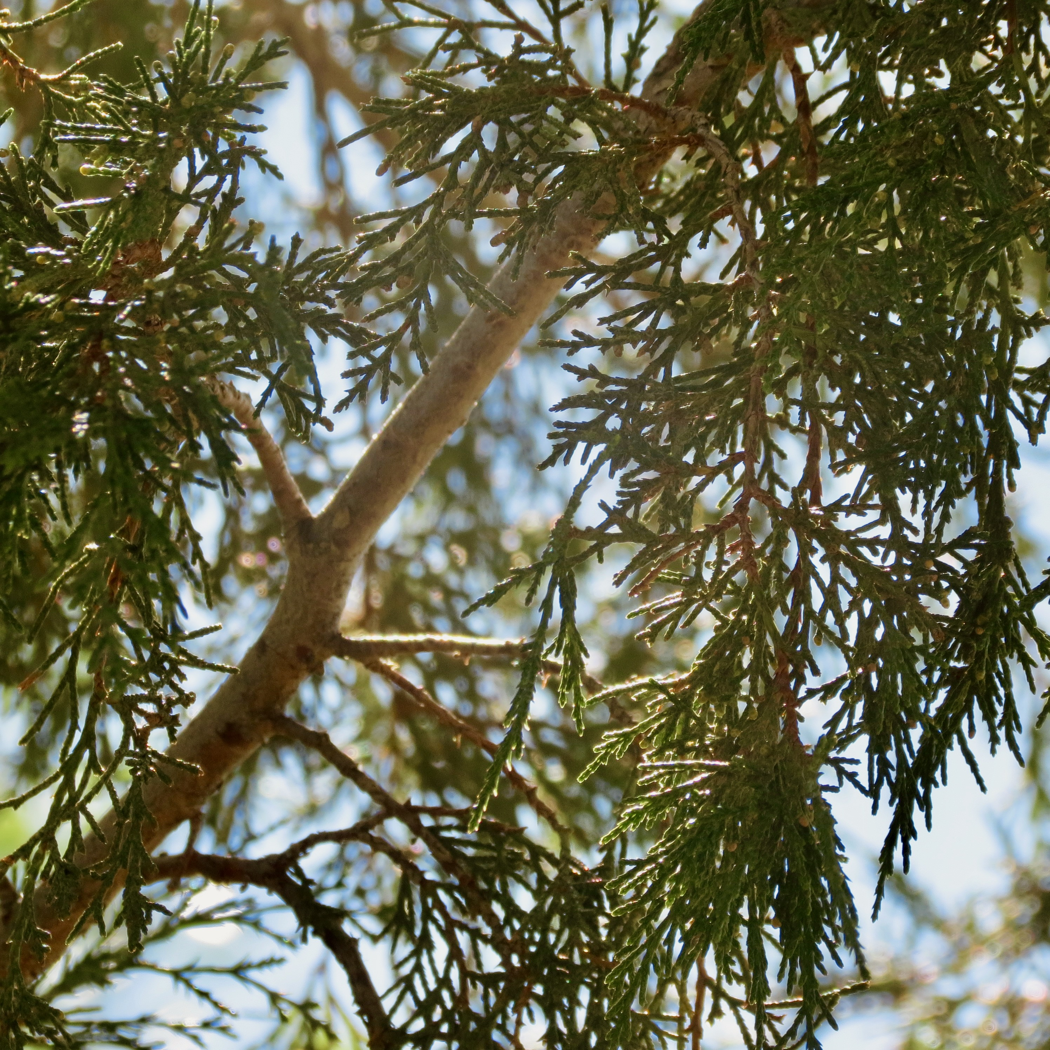
My goal with this photo was to get a good lighting example. The shadows in this are mostly visible, but the warm glow of the sun that goes around the branches makes the photo pretty.
Golden
Assignment: Lighting

Slide 12
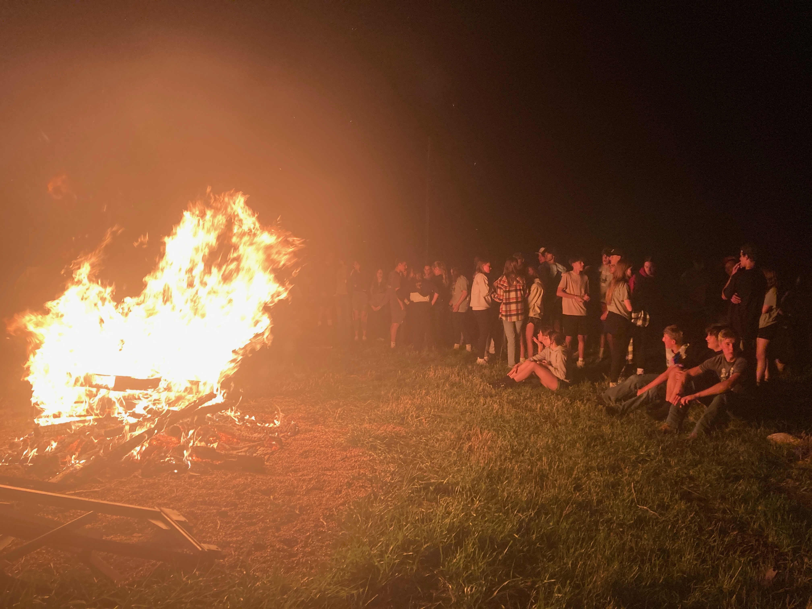
Assignment: Homecoming Photos
By the Fire
For this photo, the goal was to focus on the bonfire and people. Showing the students gathered for this school event. The light from the fire making the students visible, leaving the background dark and keeping the focus on the fire and the kids. The composition, having the fire on one half of the photo and the students on the other.

Slide 13
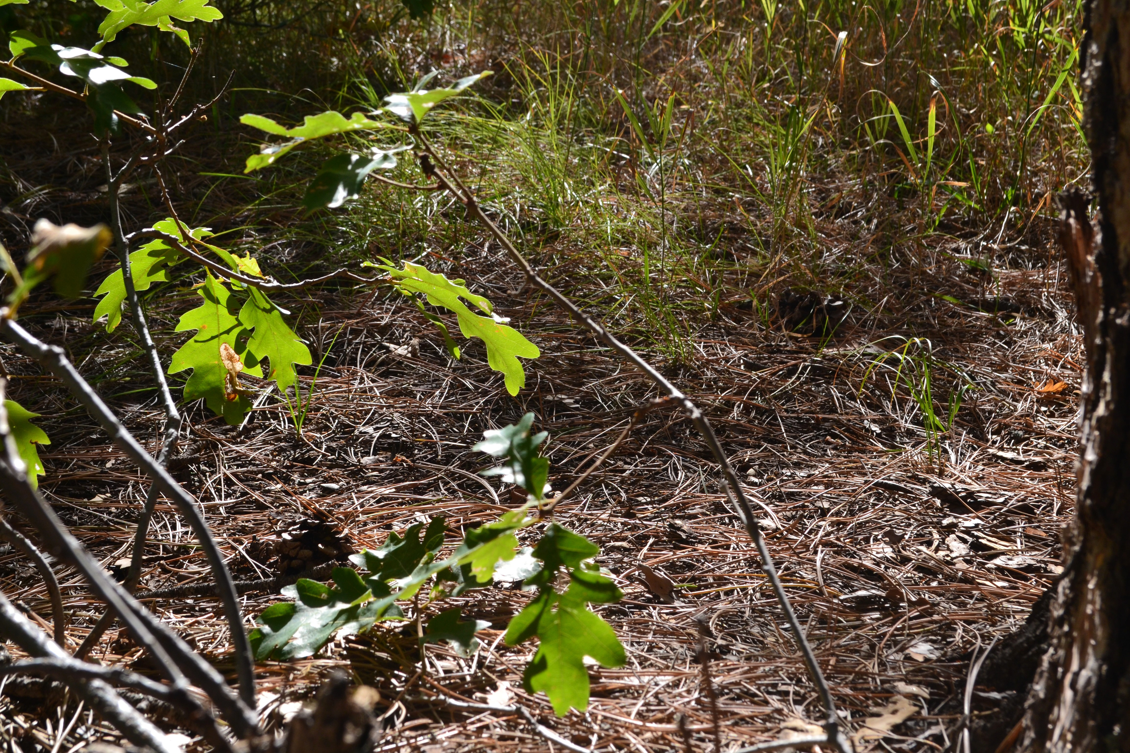
My goal for this photo was to capture the ground in detail. The pine needles covering it, the plants growing, the sticks and pinecones, every little detail. The lighting helped with this, lighting the ground beautifully. The tree on the right and the branches with leaves on the left naturally framed the photo nicely.
The Floor’s Foliage
Assignment: Up Close and Detail Landscape Photos

Slide 14
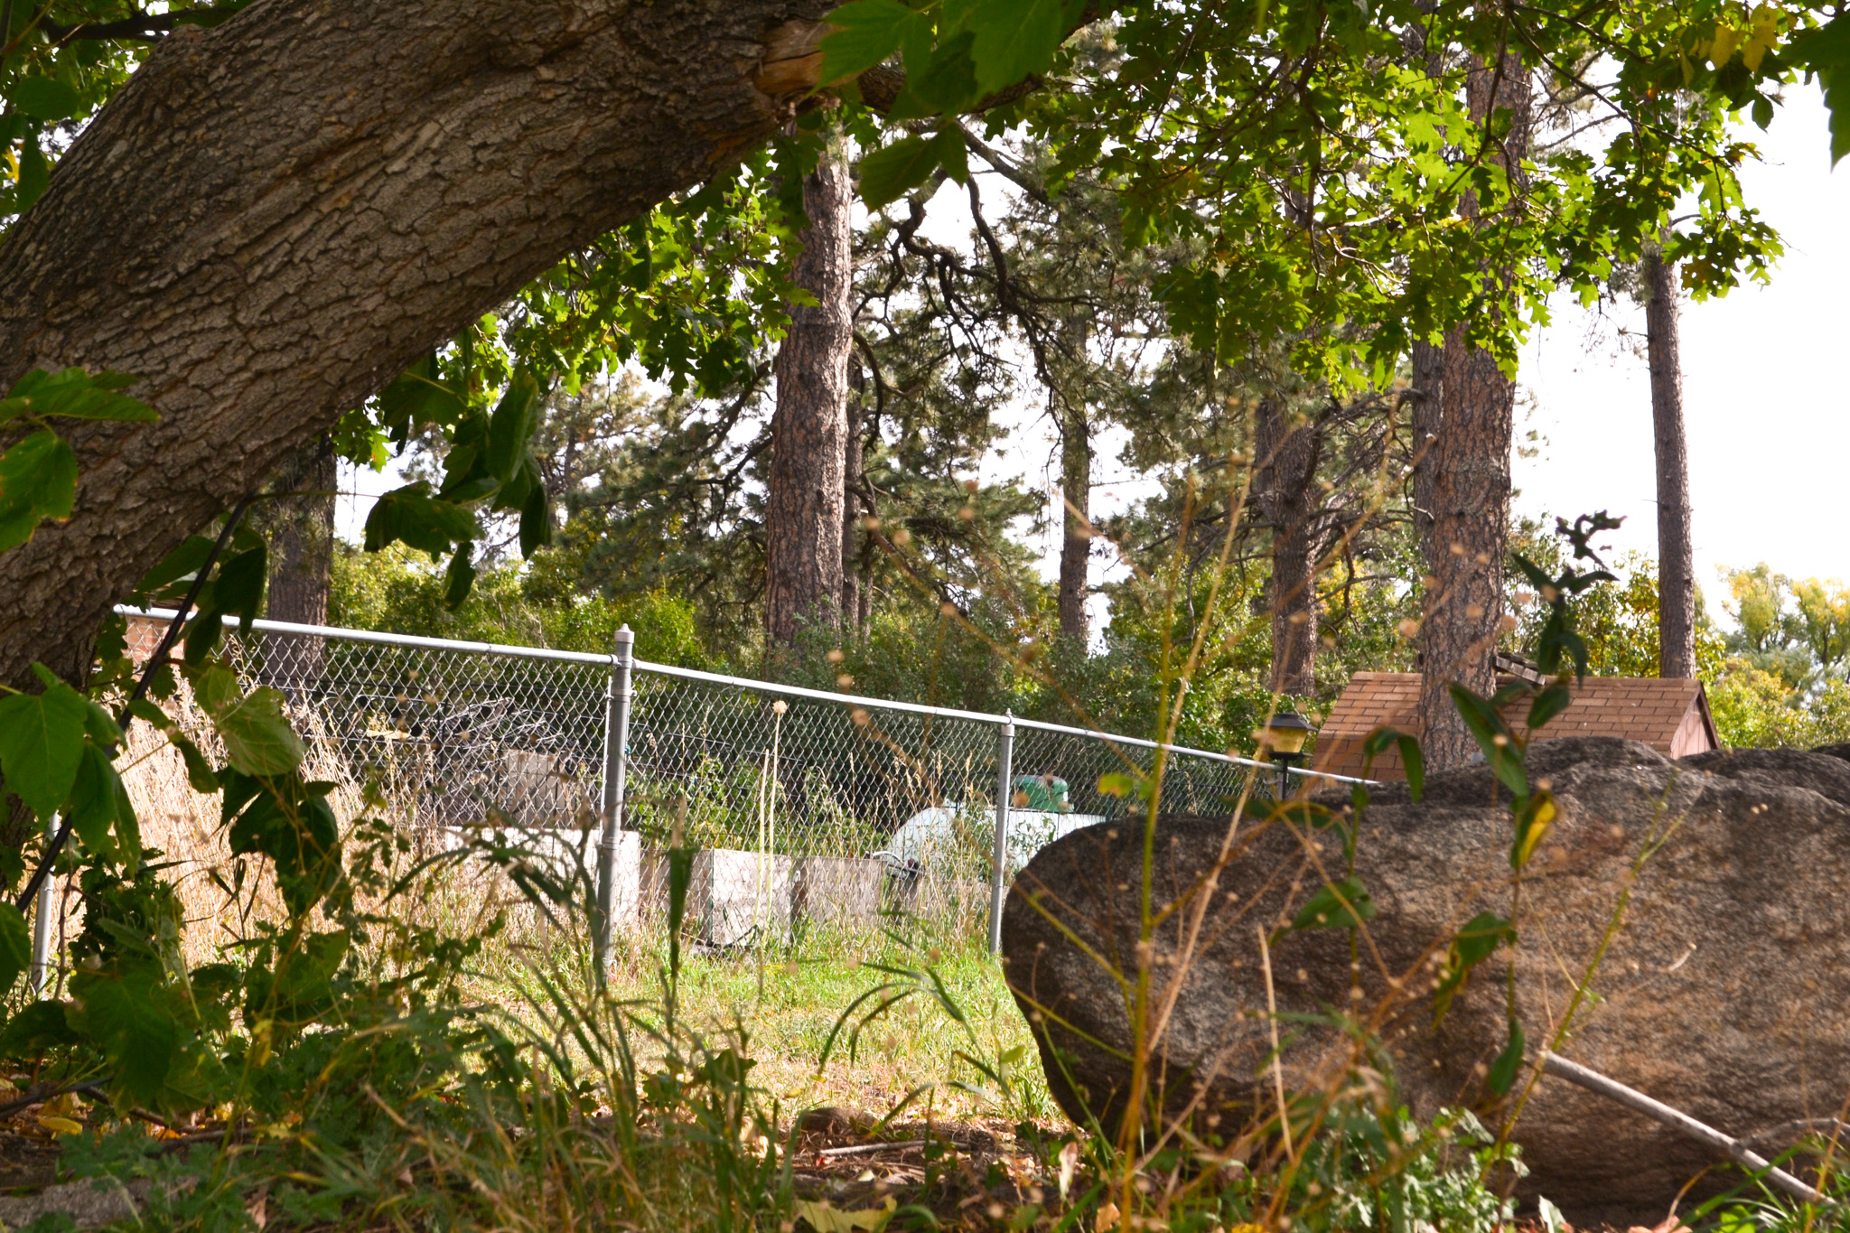
The goal for this photo was to naturally frame the bright background. The rock, tree, and plants naturally frame it in the foreground, while the fence is brightly lit.
A Lavish Lawn
Assignment: Up Close and Detail Landscape Photos
14

Slide 15
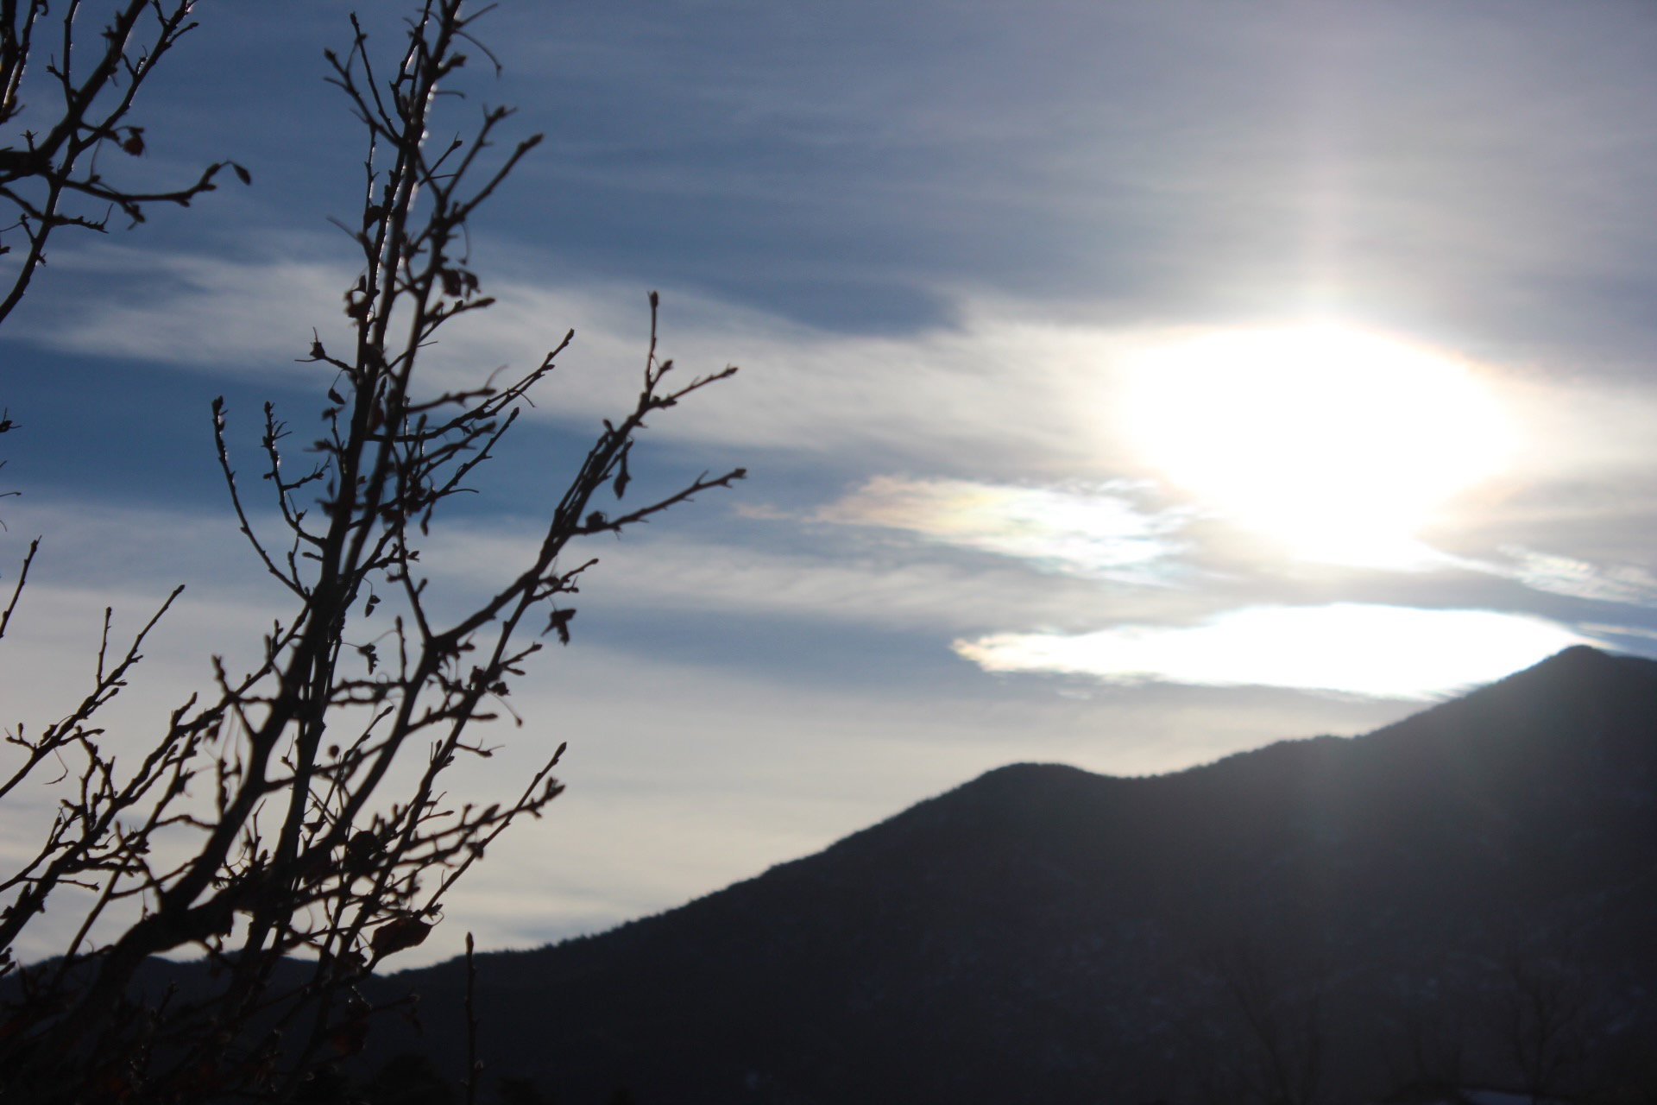
In this photo, the composition is supposed to highlight the sun and the sky. The mountains and branches are dark, framing the sun and contrasting against it.
Into the Light
Choice

Slide 16
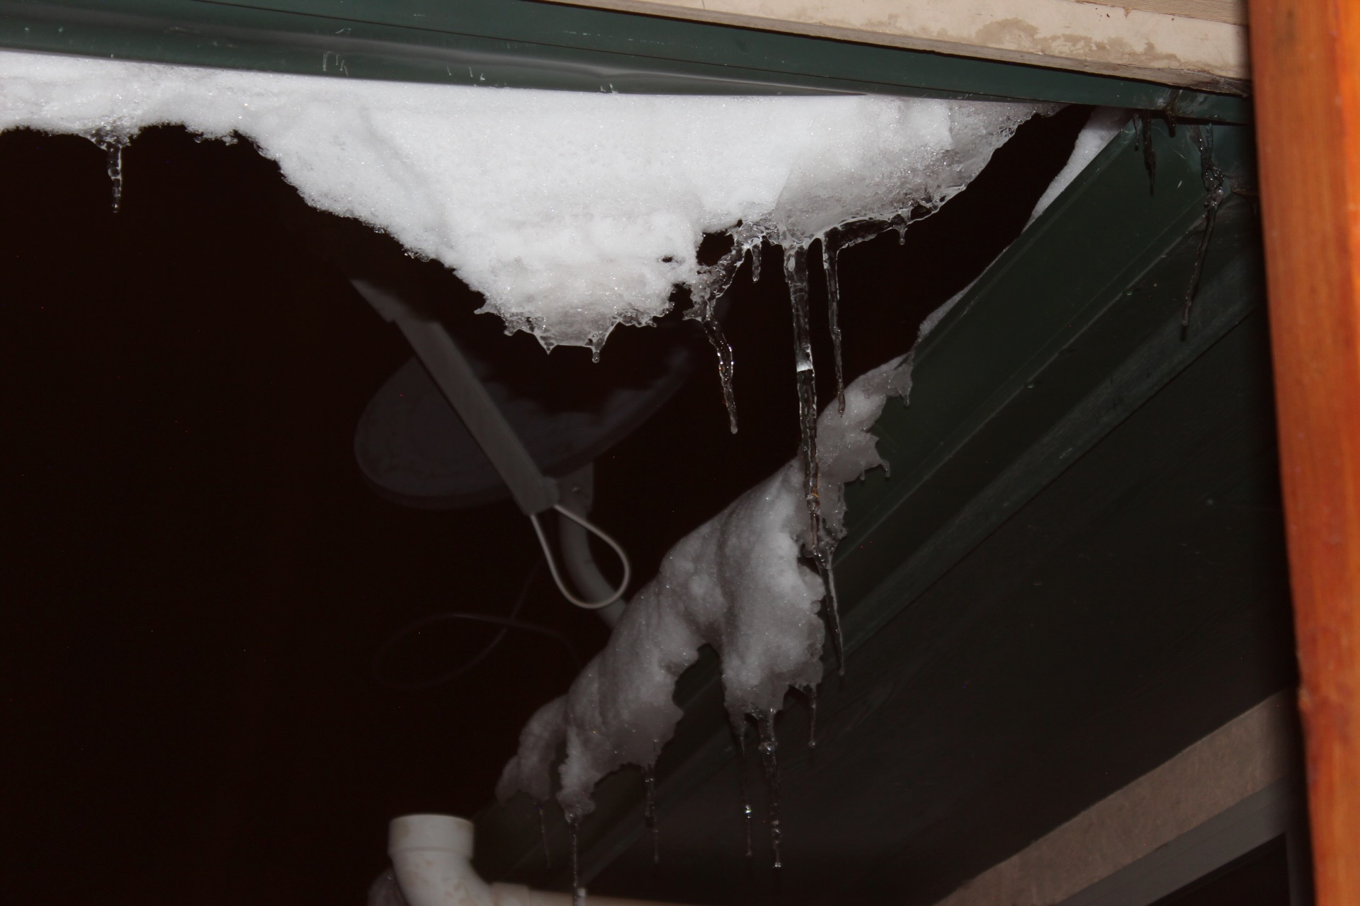
The goal focal point of this photo is the snow and icicles. This was achieved by taking the photo at night with flash, catching on the glittery snow and ice. The rest of the image is dark, further focusing on the snow and icicles.
Icy
Choice

Slide 17
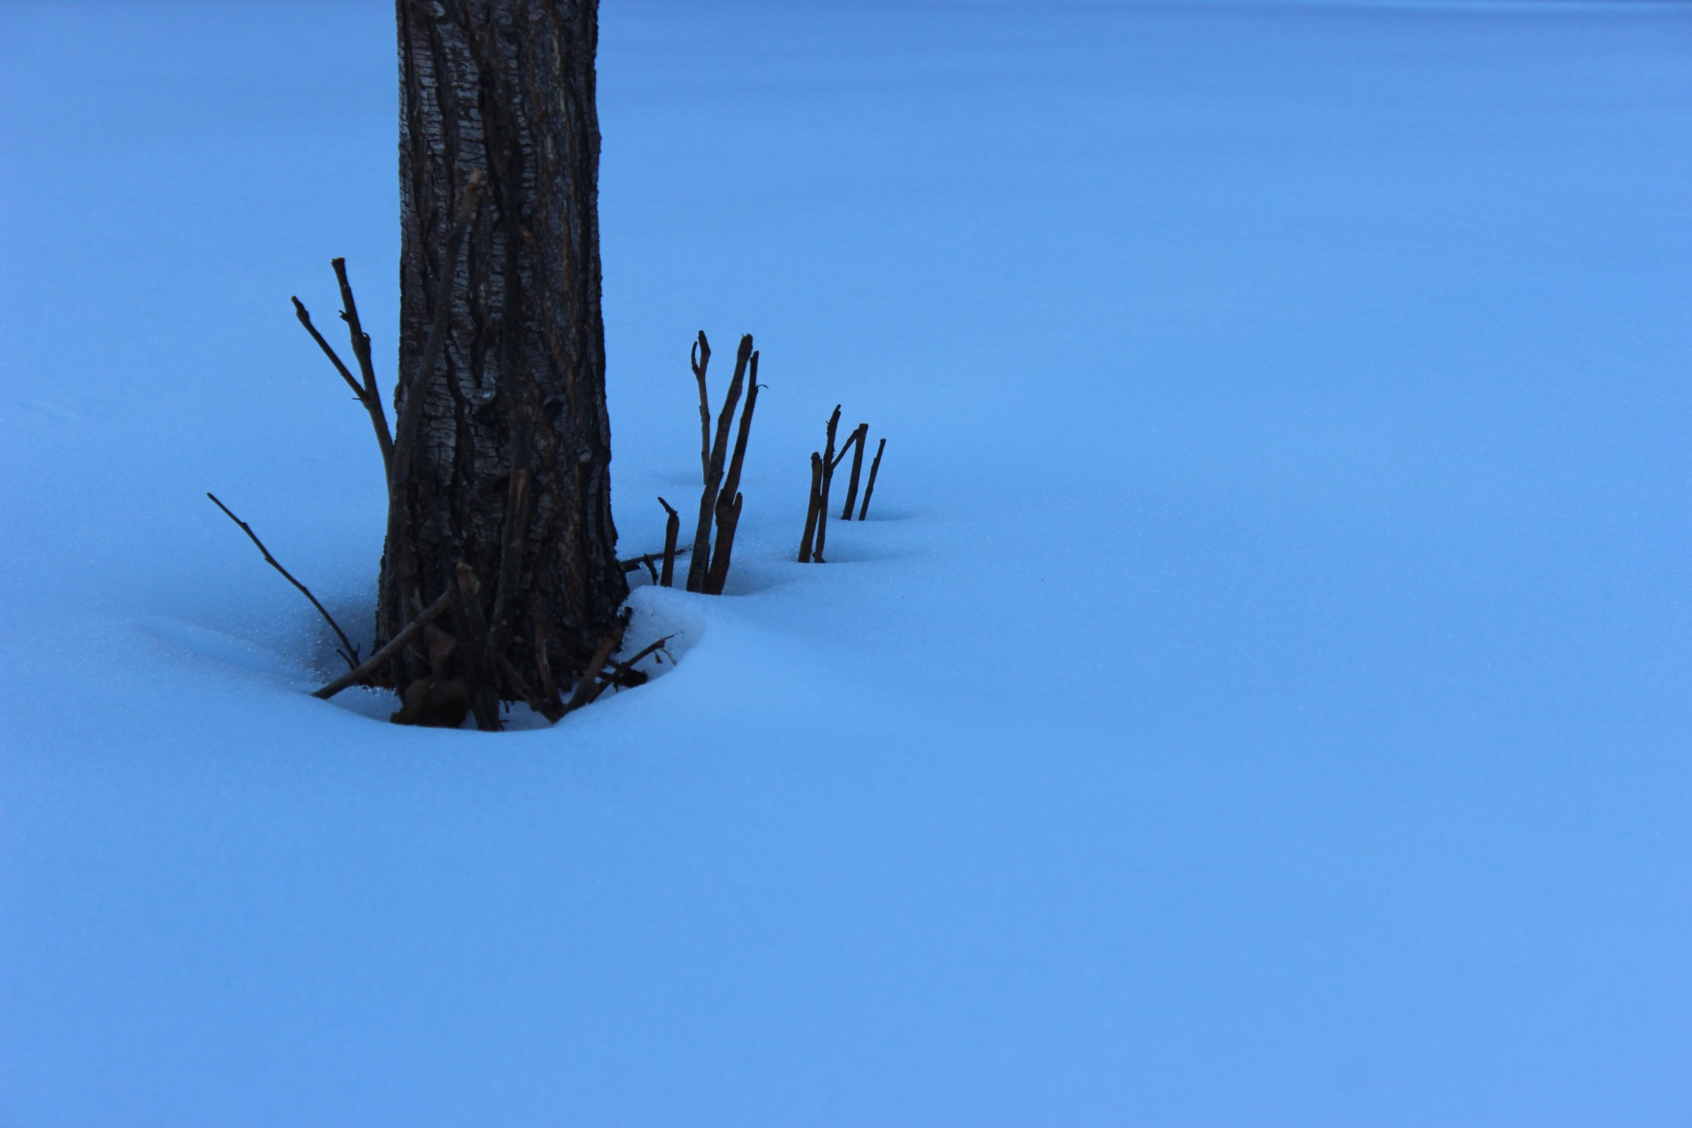
This photo’s goal was be to calm, but slightly eerie. The blue tinted, untouched snow, imperfected by the dark tree.
Impure
Choice

